Slide 1

Slurry Rate Backend Rate Drop
July 2024

Slide 2
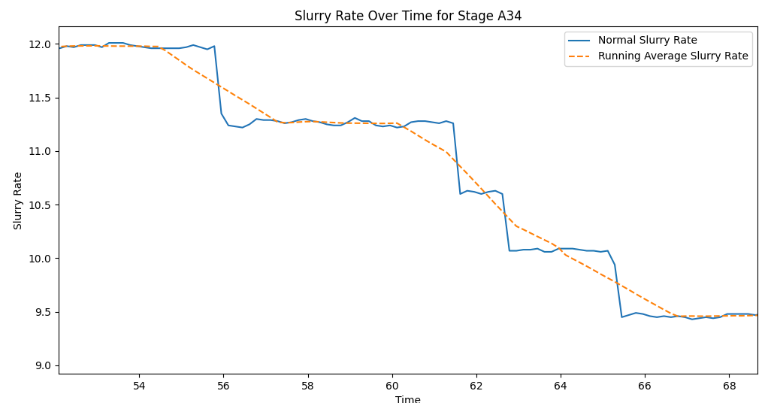
Technical Workflow Summary
1. Data Intake:
Load slurry rate data from CSV file.
2. Data Preparation:
Compute the running average slurry rate using a specified window size to smooth out short-term fluctuations.
3. Peak Identification:
Identify the all-time high (peak) in the running average slurry rate for each stage
4. Post-Peak Analysis:
Focus analysis on data points occurring after the identified peak.
Calculate the percentage drop in slurry rate from the peak for each data point.
5. Sustained Decline Detection:
Determine if the slurry rate has declined beyond a specified drop threshold.
Check if this decline is sustained for a minimum time period, defined as a percentage of the total time.
6. Stage Classification:
Classify each stage as having a backend rate drop-off if a sustained decline is detected.
Return results indicating which stages have a backend rate drop-off.

Slide 3
